Slide 1
BLOCKCHAIN Introduction and implementation

Slide 2

HELLO!
Notes:
Variety of knowledge in the audience
Some of this might be too basic, some of it might be too advance
Push through the basic portions, ask questions in advance portion
Technical portion: you’re my guinea pigs

Slide 3
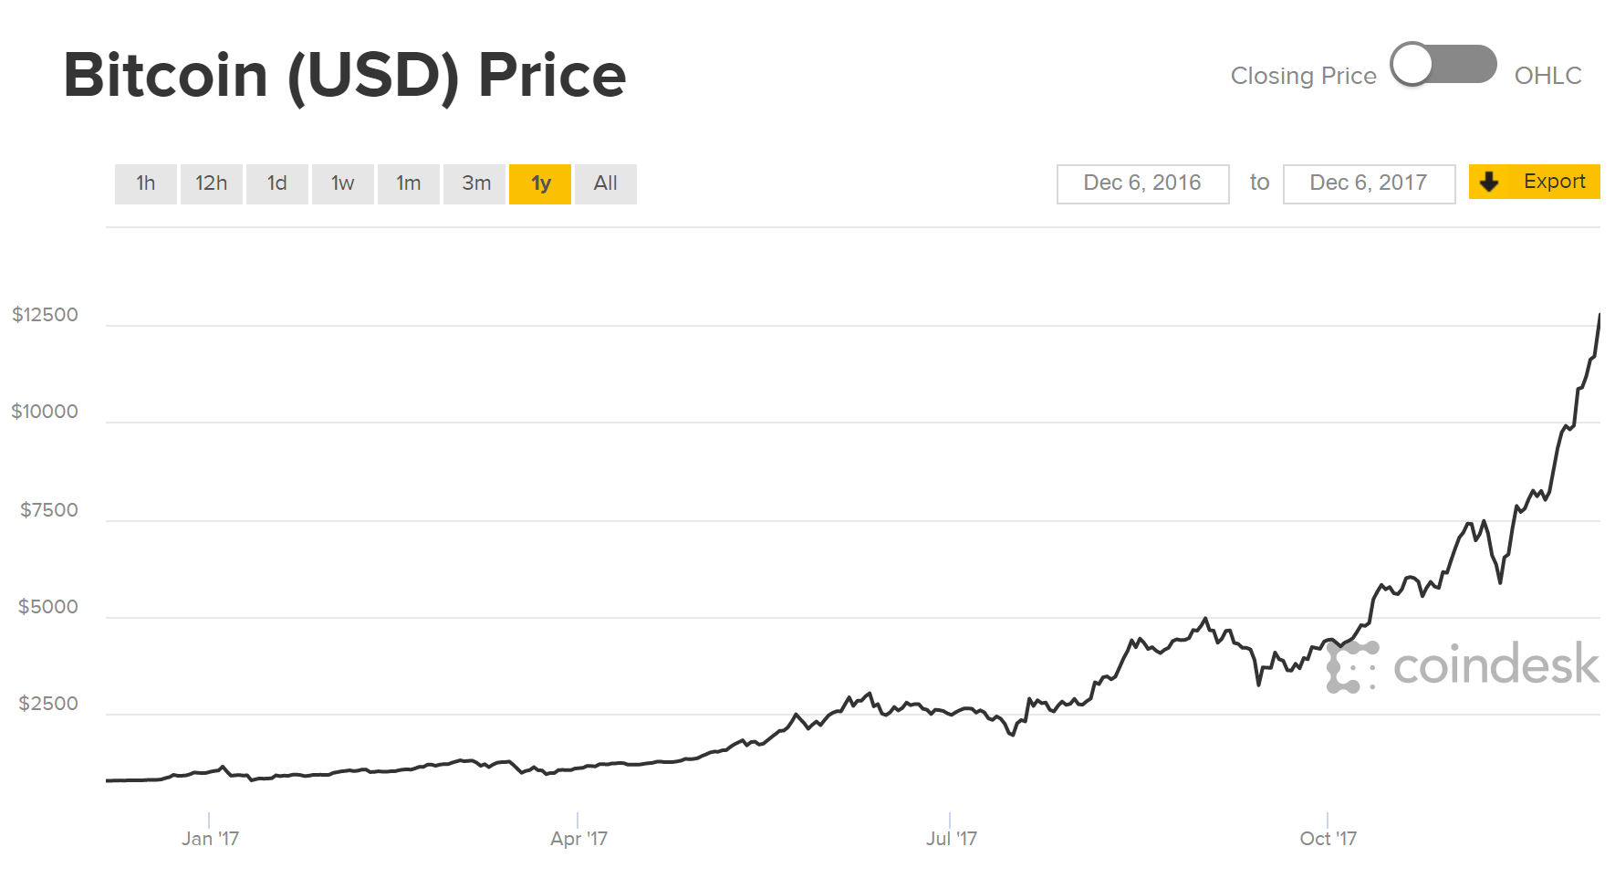
Notes:
Why such an interest in Blockchain

Slide 4

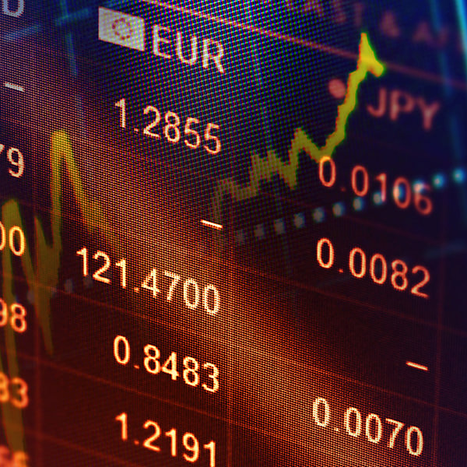


Slide 5
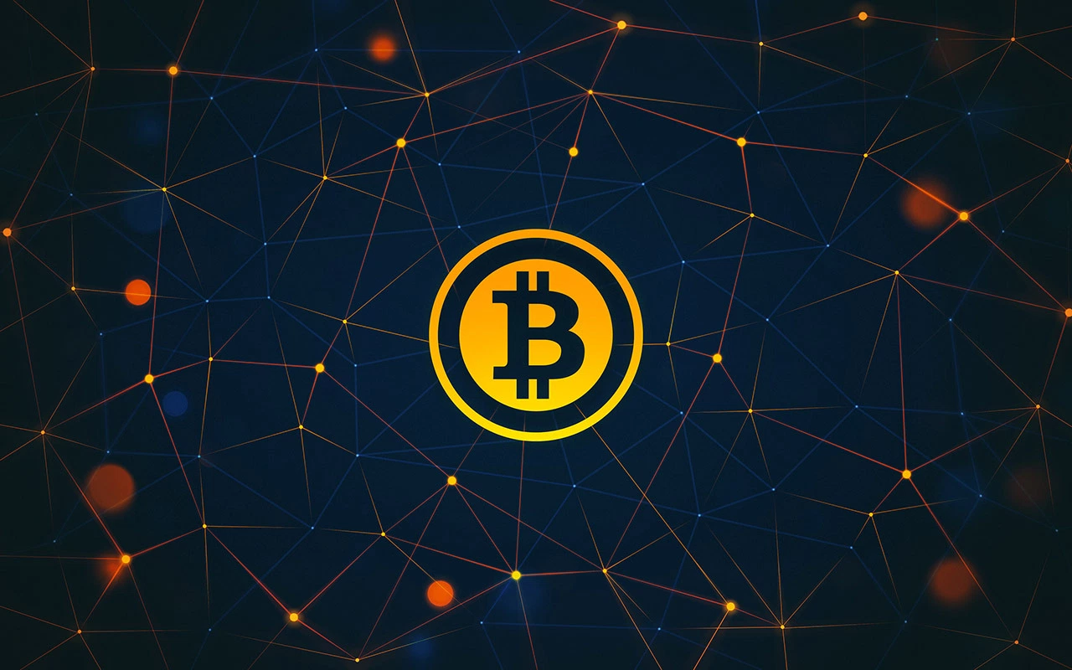

Slide 6
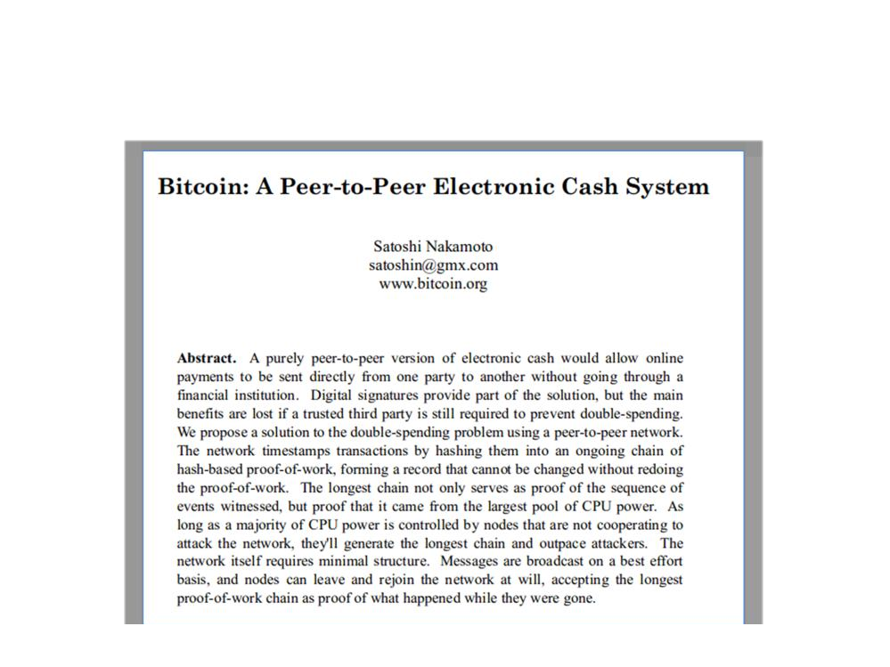
History of Bitcoin
[2008 Oct] Satoshi Nakamoto releases the whitepaper
Notes:
Whitepaper is 8 pages long

Slide 7
History of Bitcoin
[2008 Oct] Satoshi Nakamoto releases the whitepaper
[2009 Jan] Network materializes with first client
Notes:
Whitepaper is 8 pages long

Slide 8
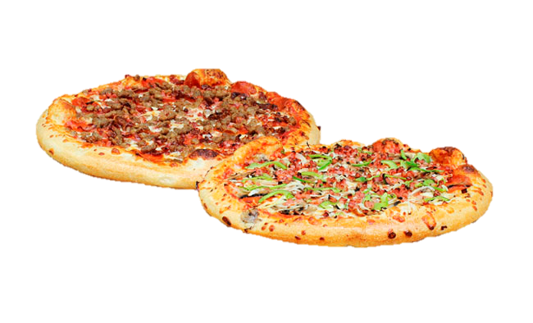
History of Bitcoin
[2008 Oct] Satoshi Nakamoto releases the whitepaper
[2009 Jan] Network materializes with first client
[2010 May] Laszlo Hanyecz paid 10,000 BTC for two pizzas
Notes:
Whitepaper is 8 pages long

Slide 9
History of Bitcoin
[2008 Oct] Satoshi Nakamoto releases the whitepaper
[2009 Jan] Network materializes with first client
[2010 May] Laszlo Hanyecz paid 10,000 BTC for two pizzas
[2011 Feb] 1 BTC = 1 USD
[2011 Jun] Wikileaks begins to accept BTC for donations
Notes:
Whitepaper is 8 pages long

Slide 10

History of Bitcoin
[2008 Oct] Satoshi Nakamoto releases the whitepaper
[2009 Jan] Network materializes with first client
[2010 May] Laszlo Hanyecz paid 10,000 BTC for two pizzas
[2011 Feb] 1 BTC = 1 USD
[2011 Jun] Wikileaks begins to accept BTC for donations
[2014 Mar] 850,000 BTC stolen from Mt. Gox (> $450 million)
Notes:
Mark Karpales

Slide 11
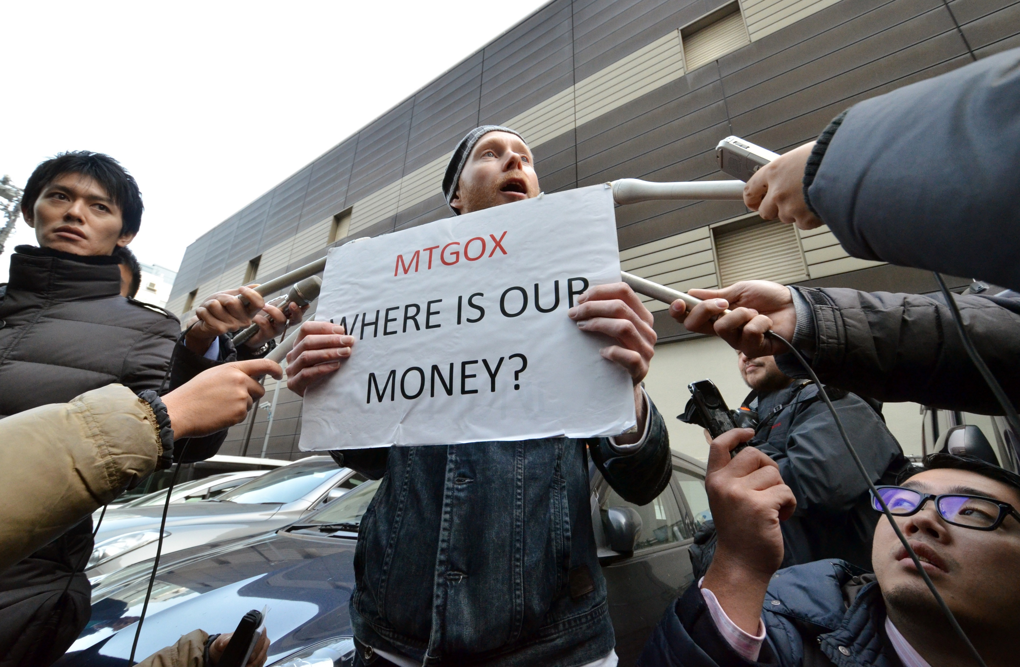

Slide 12
History of Bitcoin
[2008 - 10] Satoshi Nakamoto releases the whitepaper
[2009 - 01] Network materializes with first client
[2010 - 05] Laszlo Hanyecz paid 10,000 BTC for two pizzas
[2011 - 02] 1 BTC = 1 USD
[2011 - 06] Wikileaks begins to accept BTC for donations
[2014 - 03] 850,000 BTC stolen from Mt. Gox (> $450 million)
[2016 - 08] 120,000 BTC stolen from Bitfinex (~ $60 million)
[2017 - 08] Bitcoin forks into BTC and Bitcoin Cash
Notes:
Whitepaper is 8 pages long

Slide 13
What is Bitcoin?
A digital currency which is:
decentralized
pseudo-anonymous
completely transparent
and based on a combination of proven technologies applied in a new way.
Notes:
What is a blockchain

Slide 14
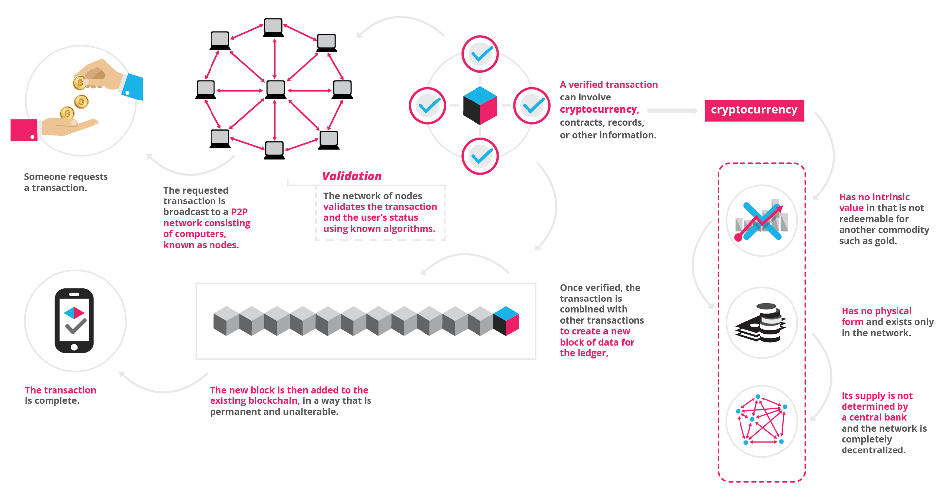

Slide 15


Slide 16
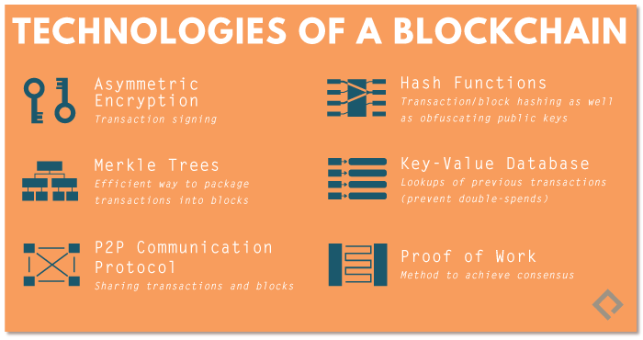

Slide 17
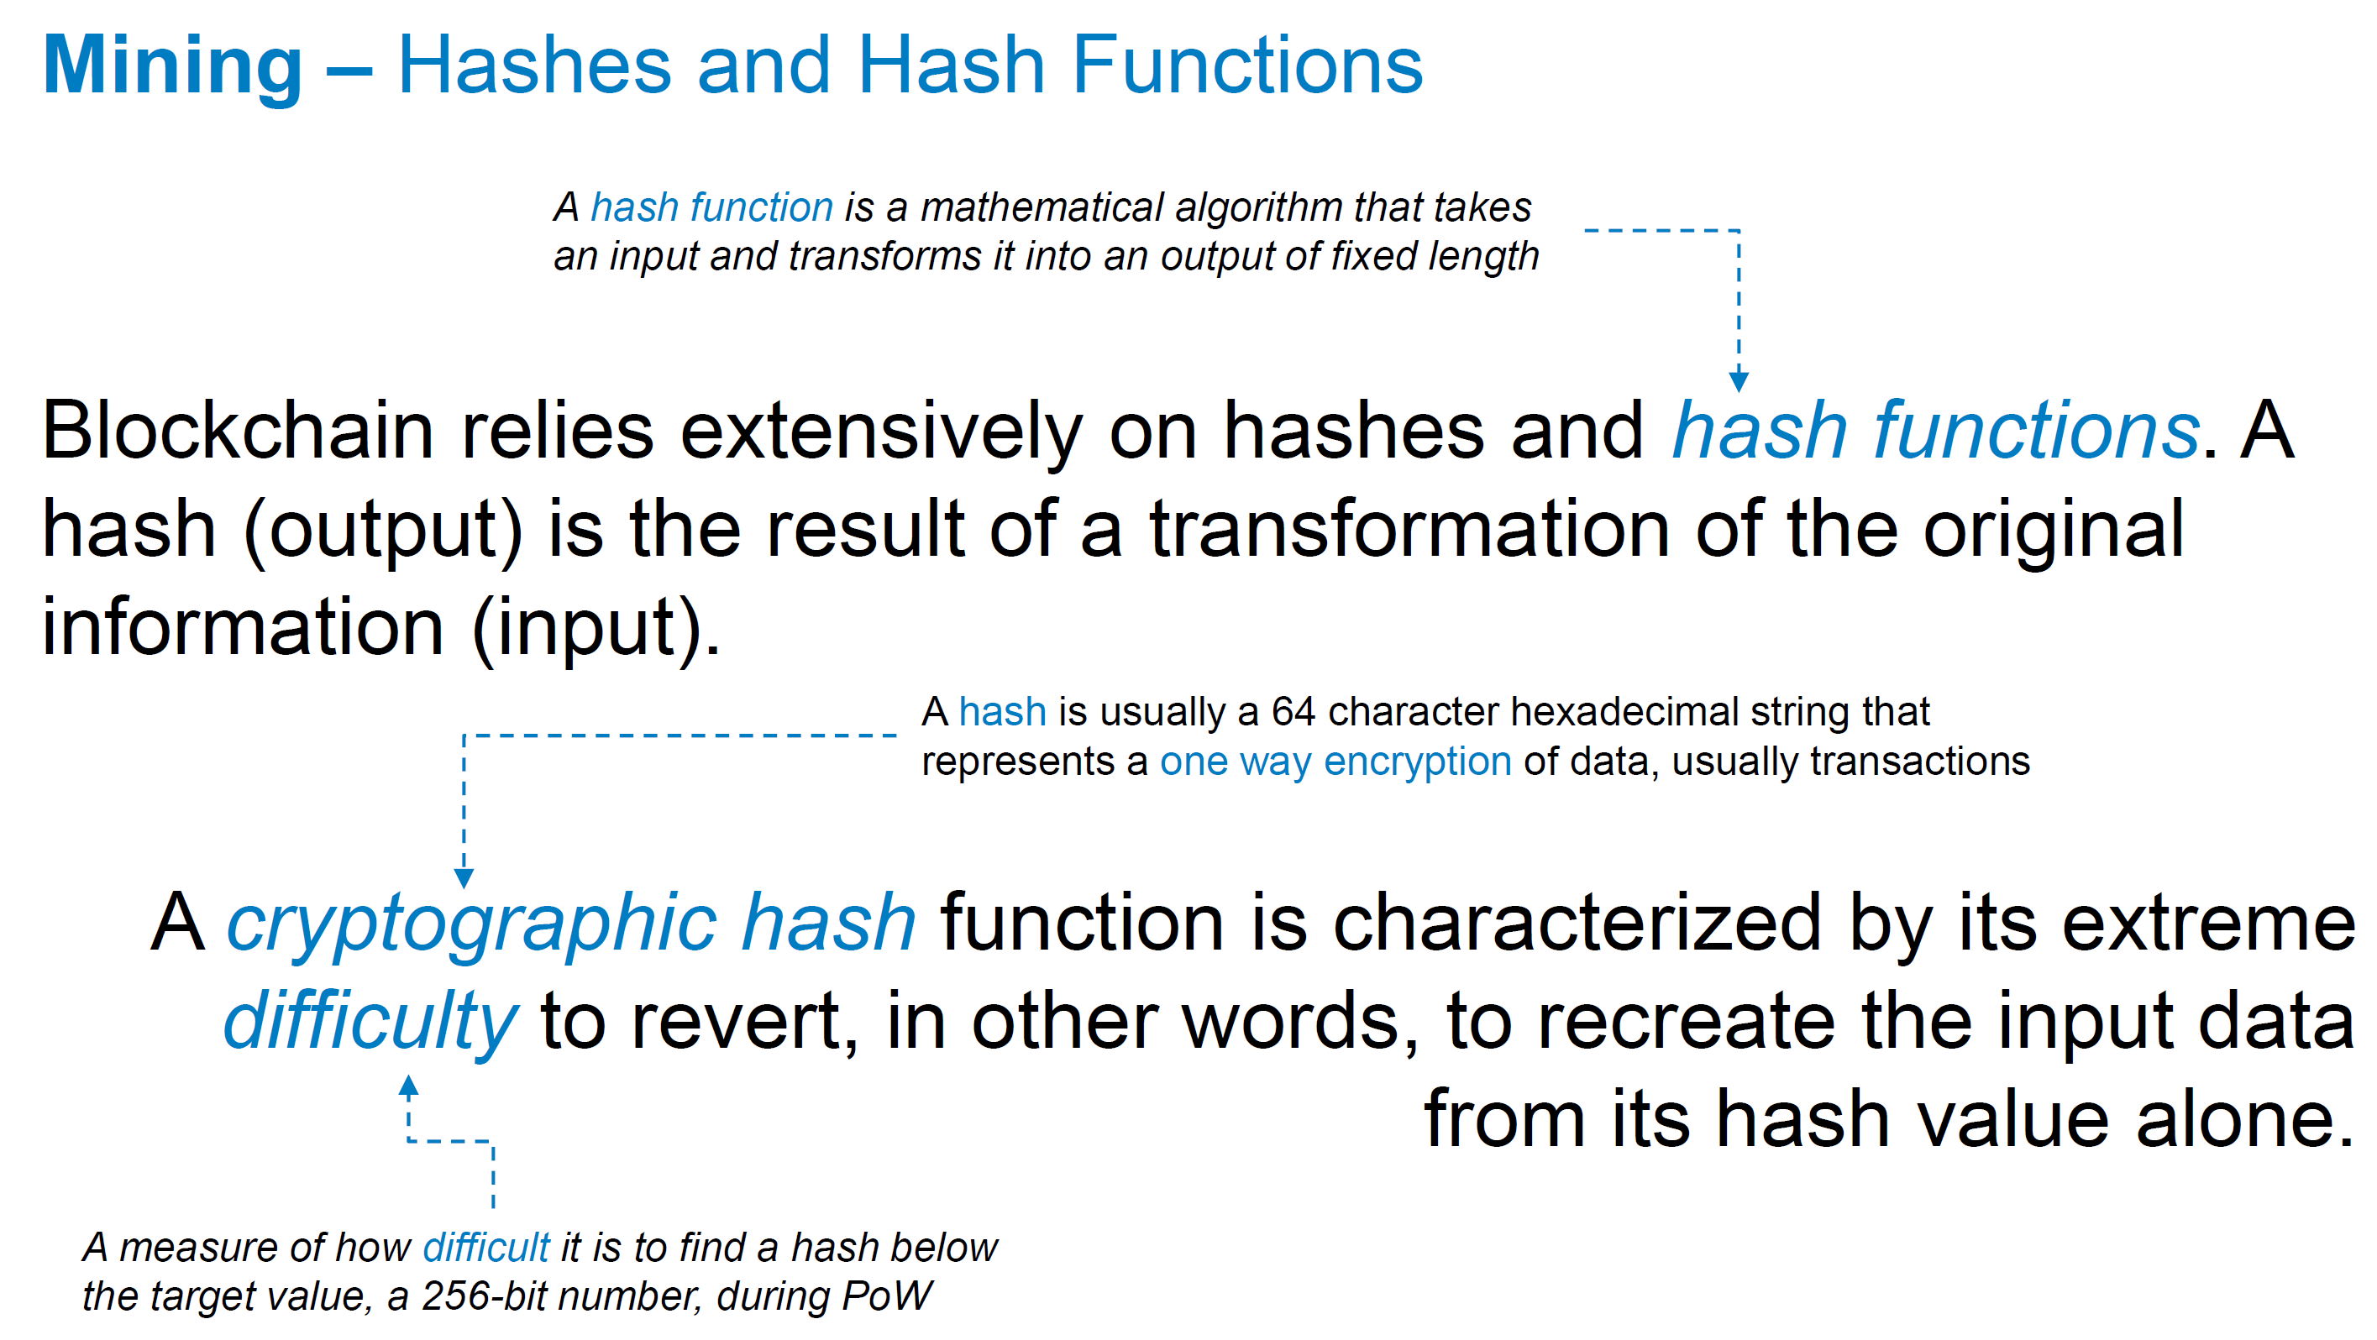

Slide 18
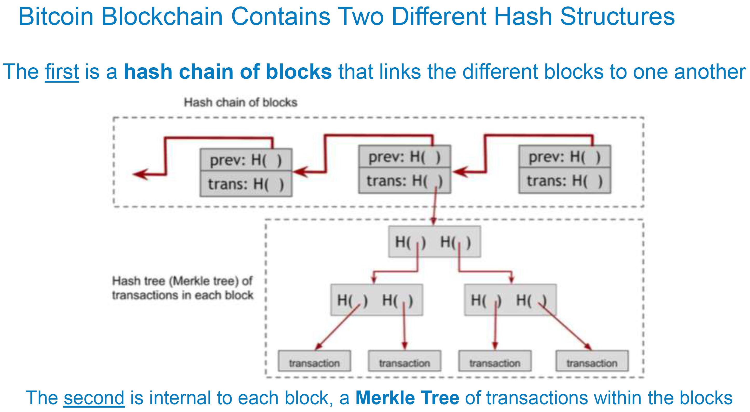

Slide 19
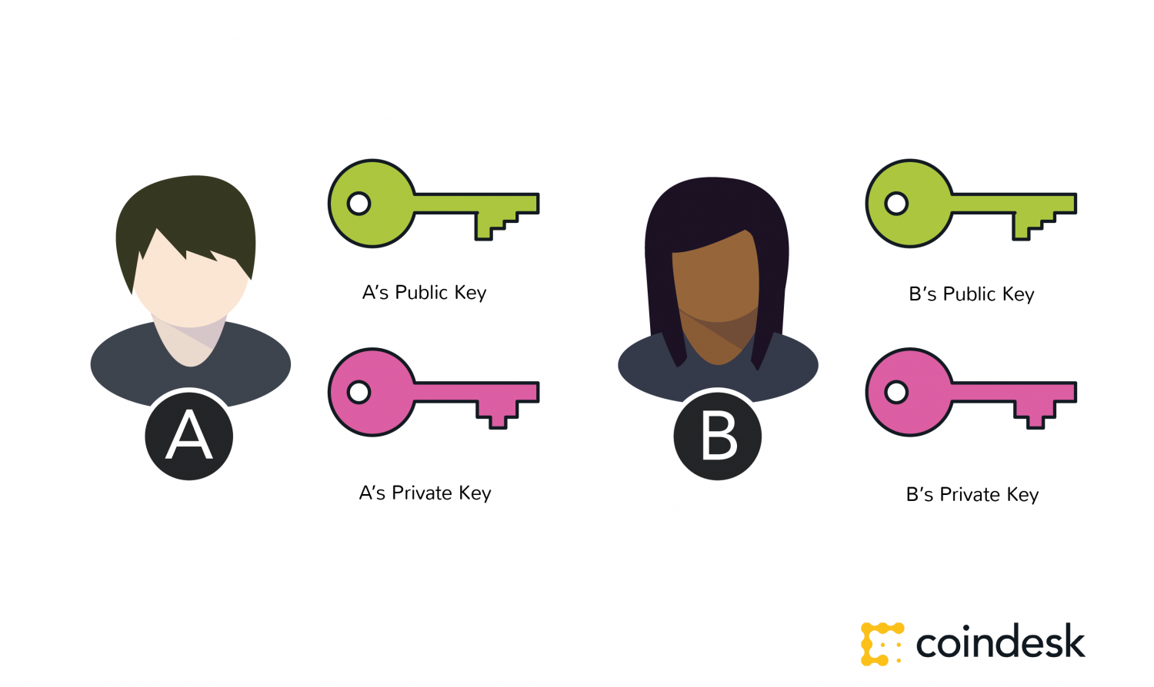

Slide 20
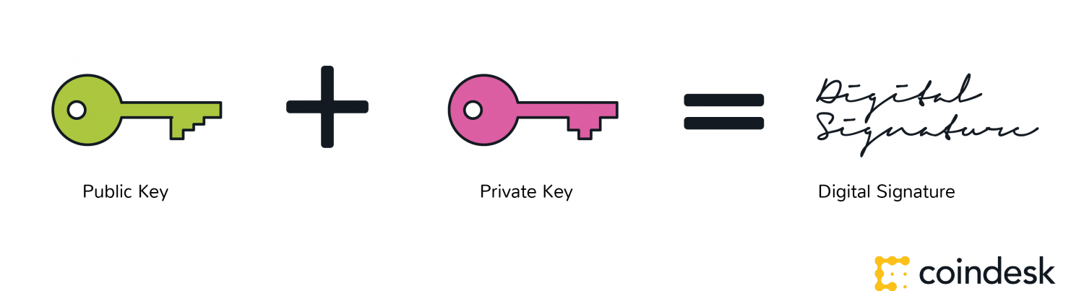

Slide 21
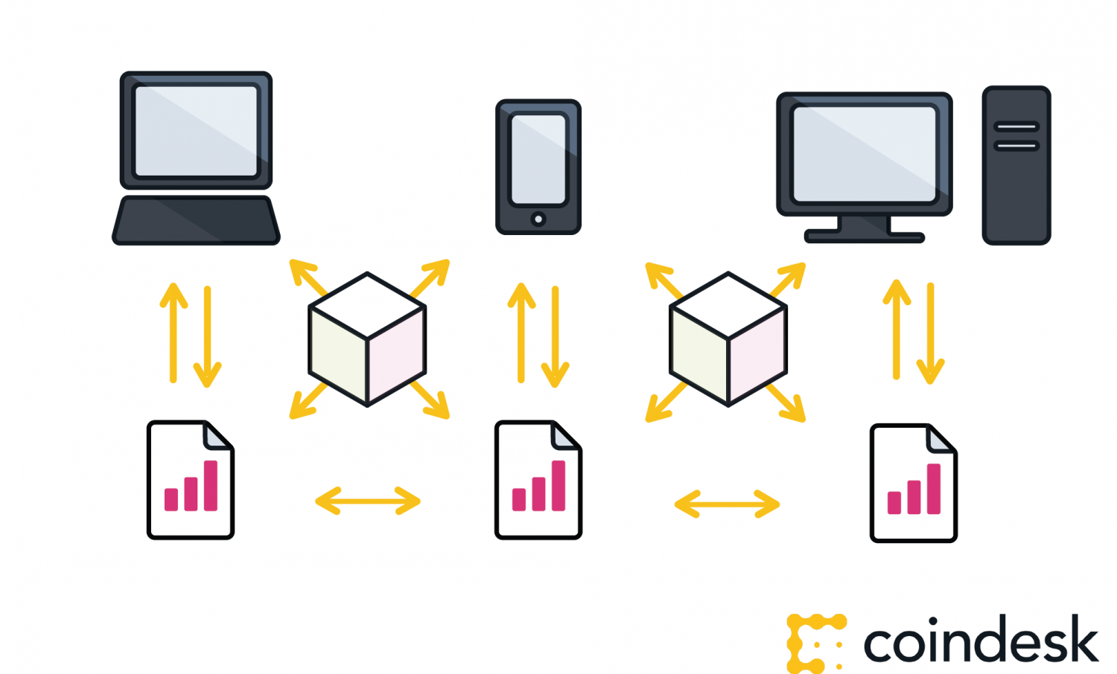

Slide 22
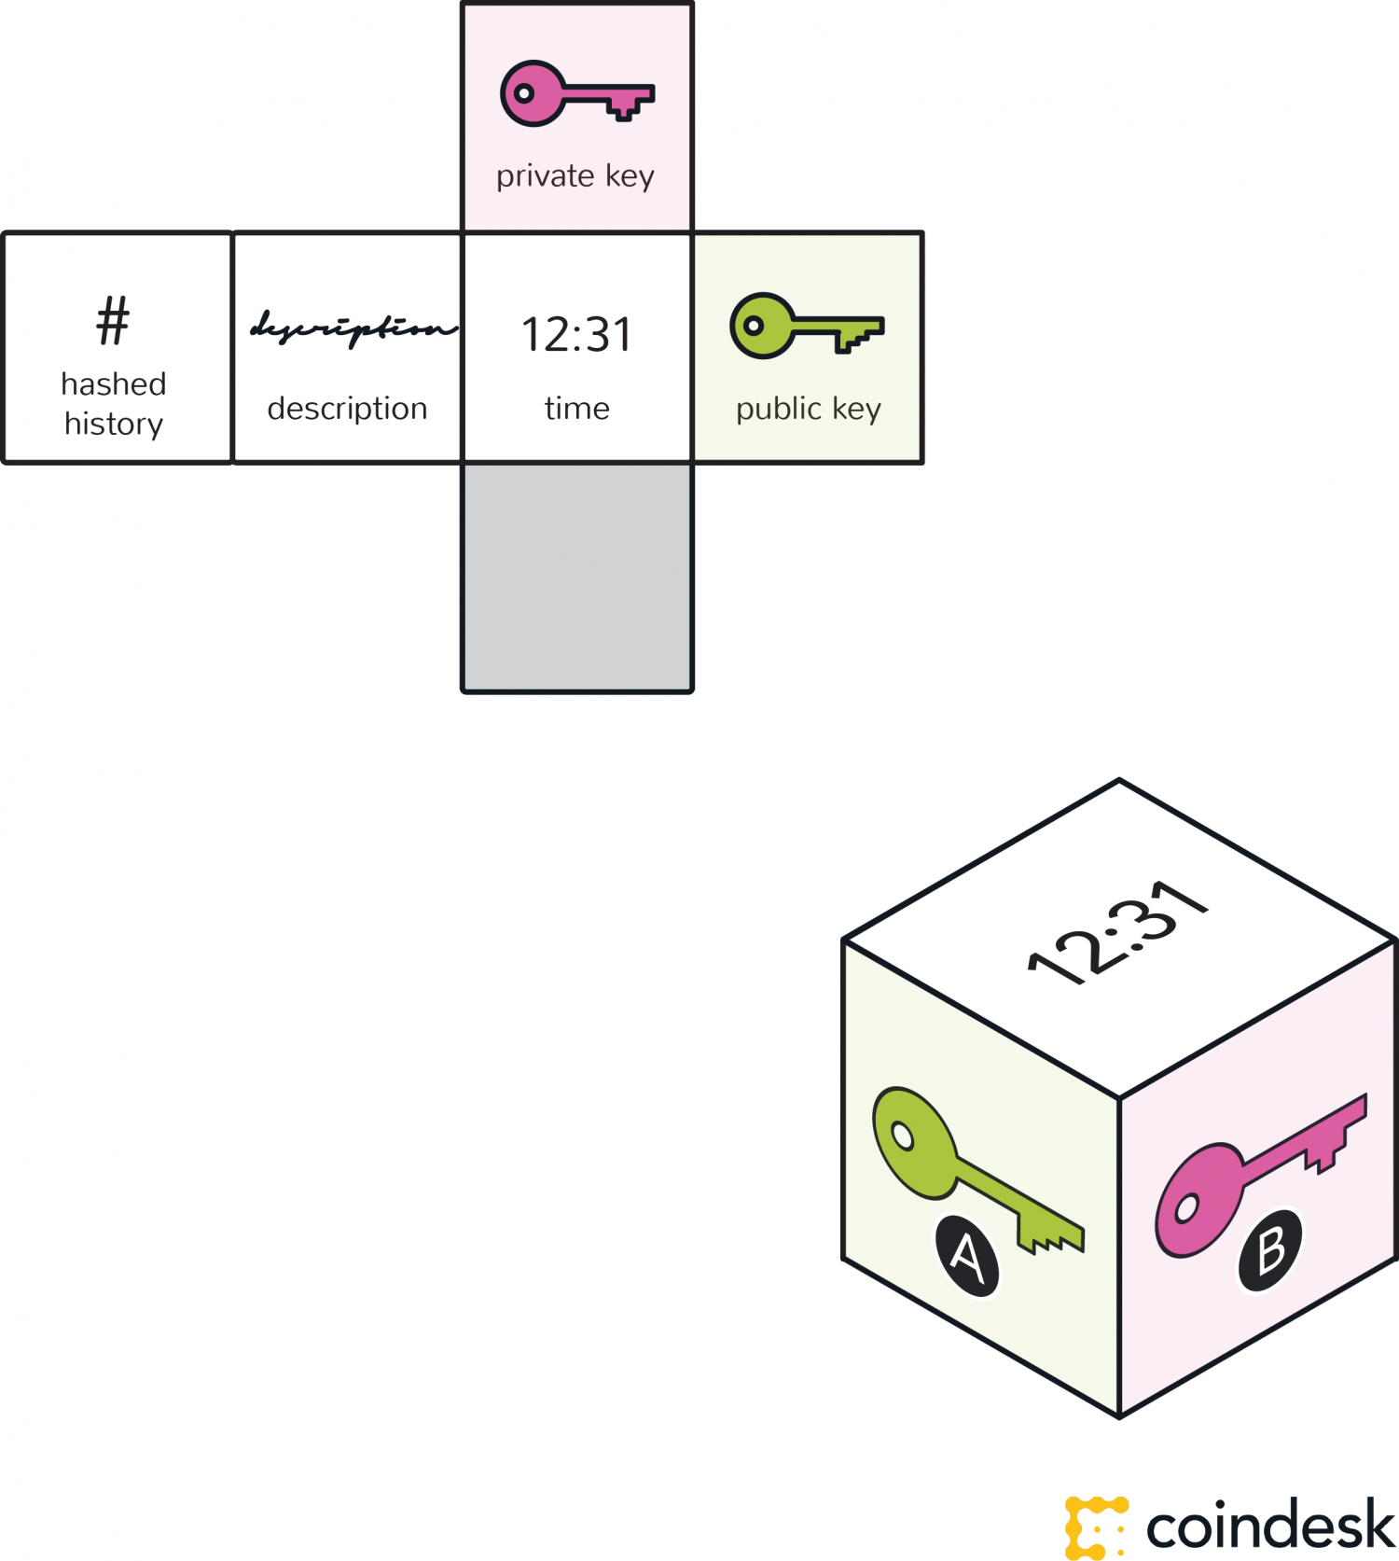

Slide 23
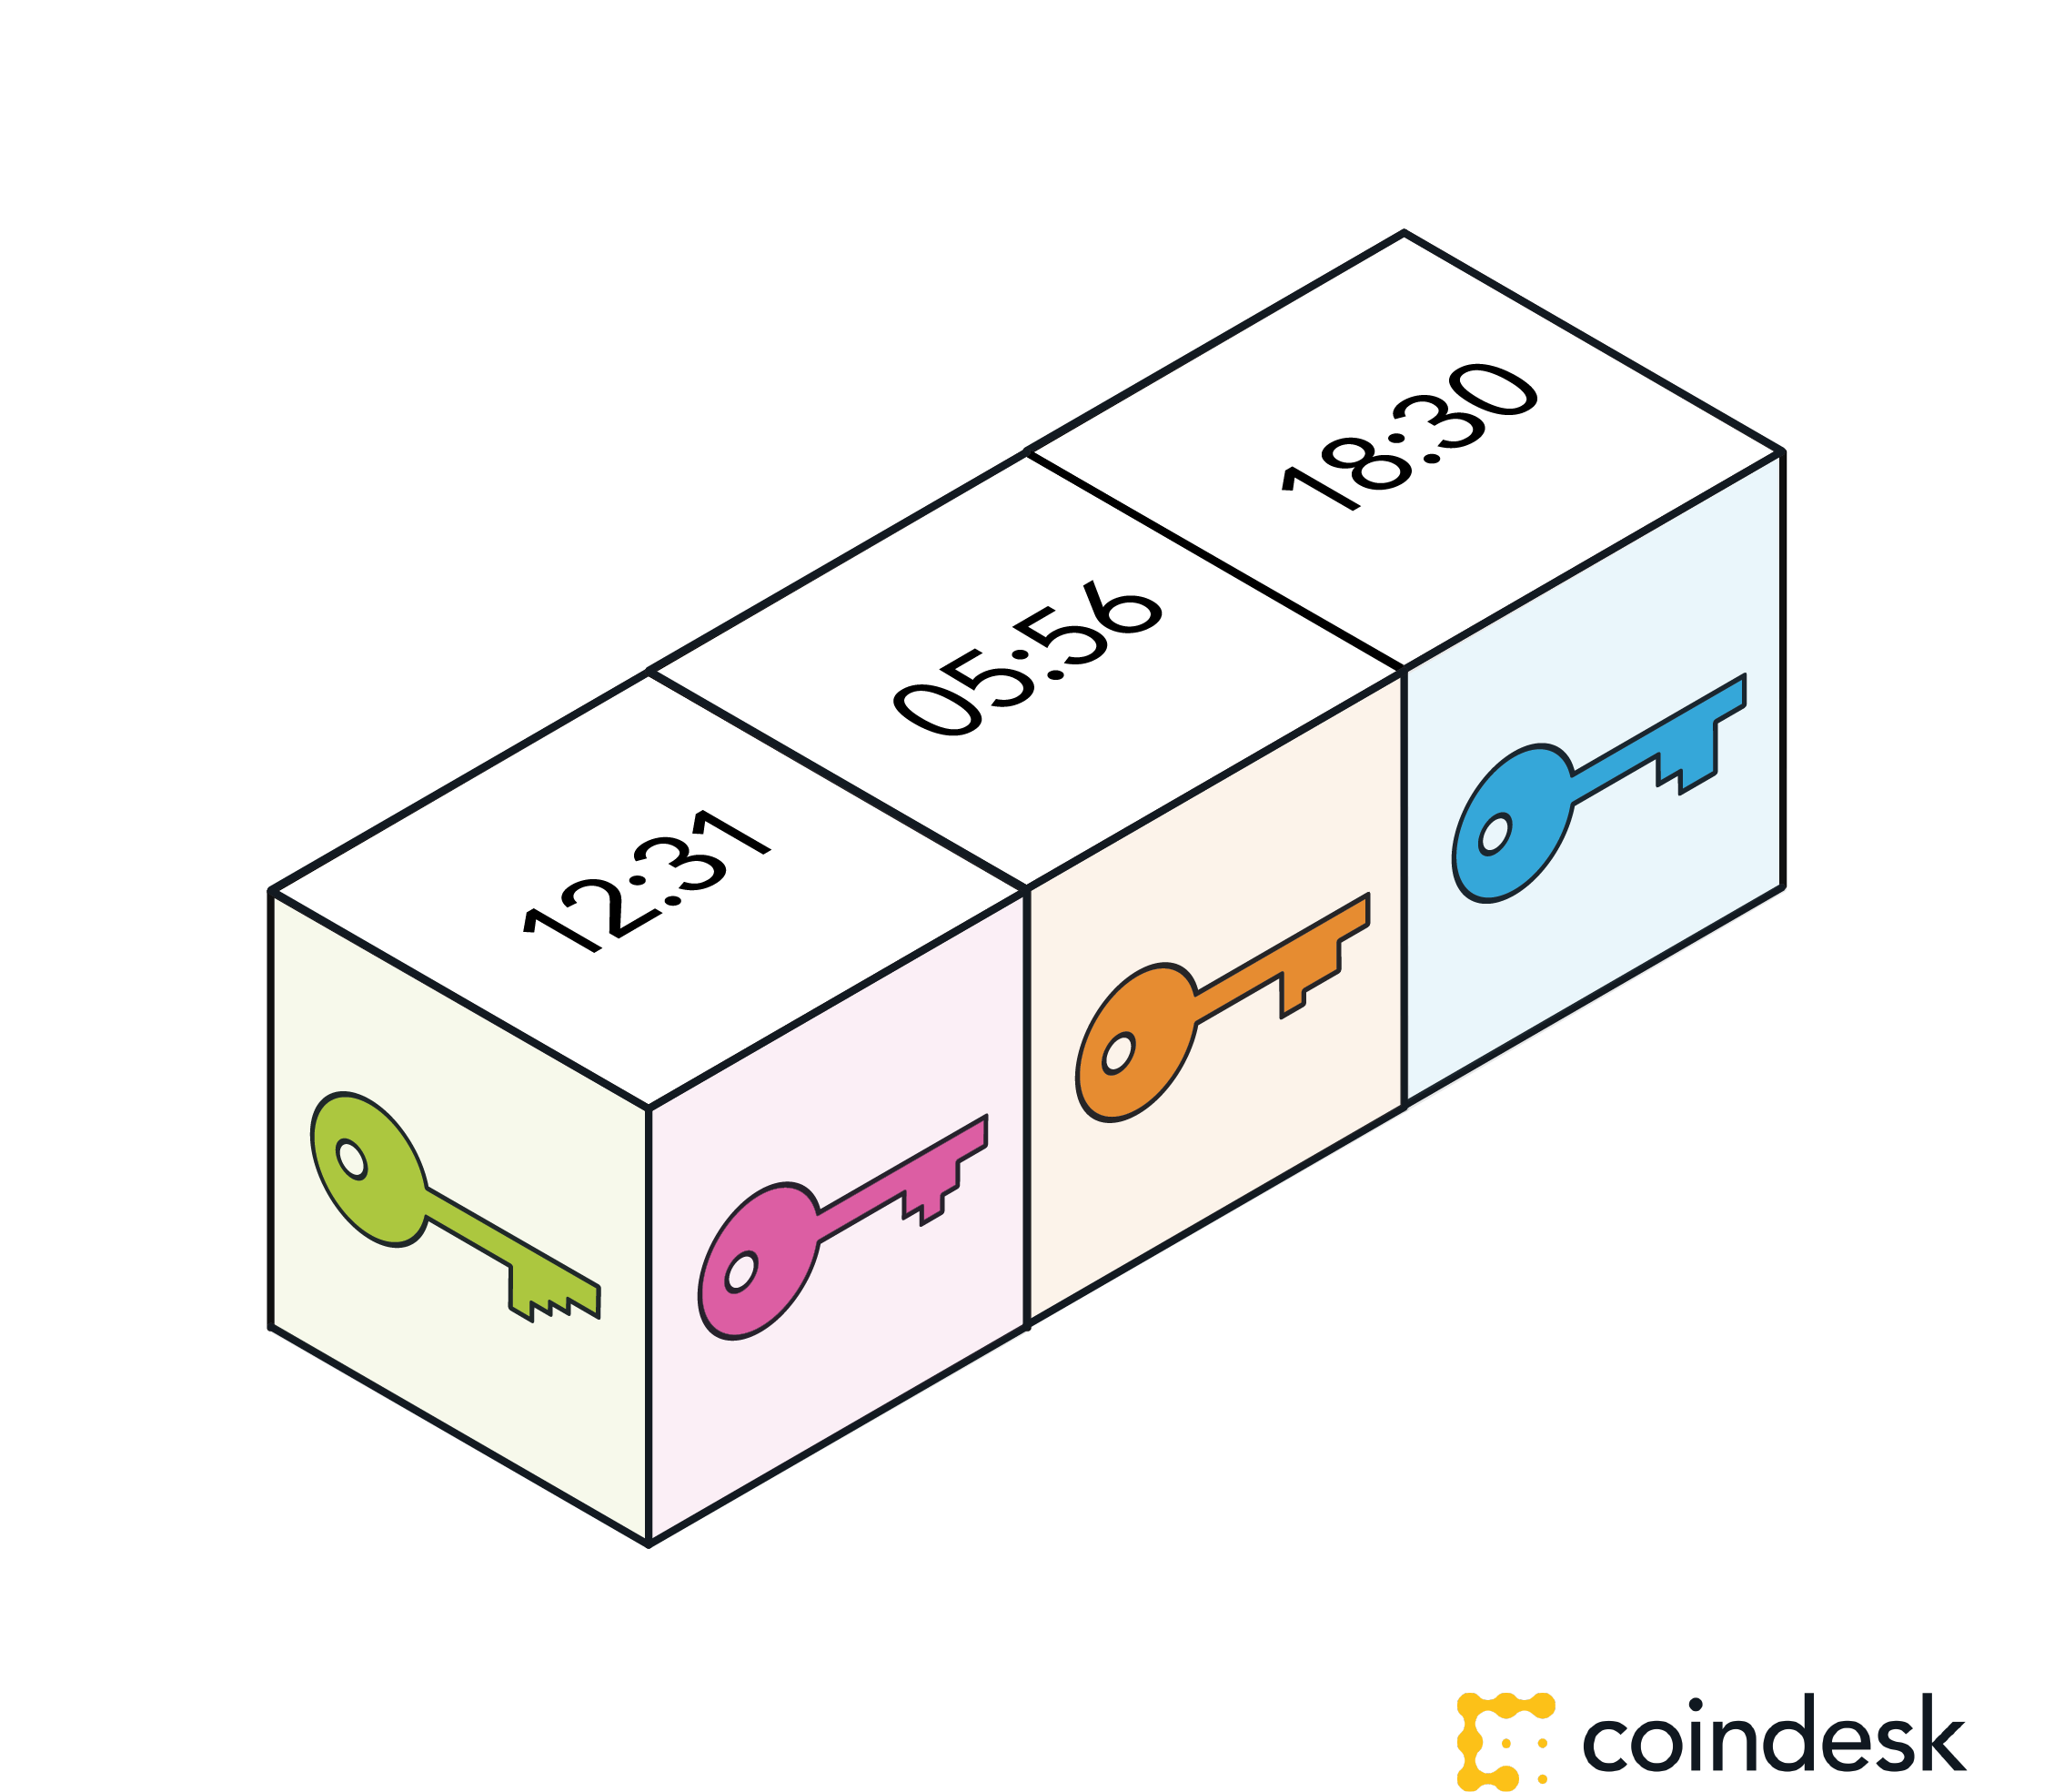

Slide 24


Slide 25
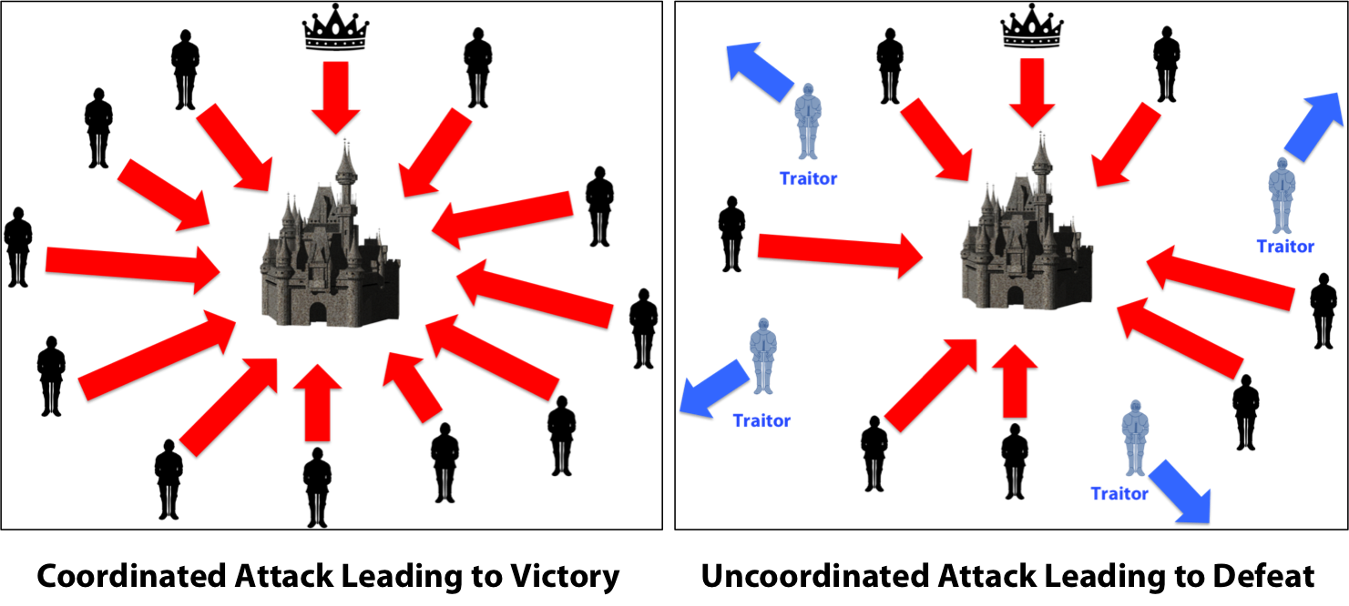
Notes:
Imagine that several divisions of the Byzantine army are camped outside an enemy city, each division commanded by its own general. The generals can communicate with one another only by messenger. After observing the enemy, they must decide upon a common plan of action. However, some of the generals may be traitors, trying to prevent the loyal generals from reaching agreement. The generals must decide on when to attack the city, but they need a strong majority of their army to attack at the same time. The generals must have an algorithm to guarantee that (a) all loyal generals decide upon the same plan of action, and (b) a small number of traitors cannot cause the loyal generals to adopt a bad plan. The loyal generals will all do what the algorithm says they should, but the traitors may do anything they wish. The algorithm must guarantee condition (a) regardless of what the traitors do. The loyal generals should not only reach agreement, but should agree upon a reasonable plan.
This ensures that once we observe a valid state of the ledger, transactions that have certain age can not be negated, because producing a longer ledger than the one we see requires the malicious entity to have computing power that can compete with the entire existing network. Consequently, these transactions have lasting consensus regarding their validity.

Slide 26
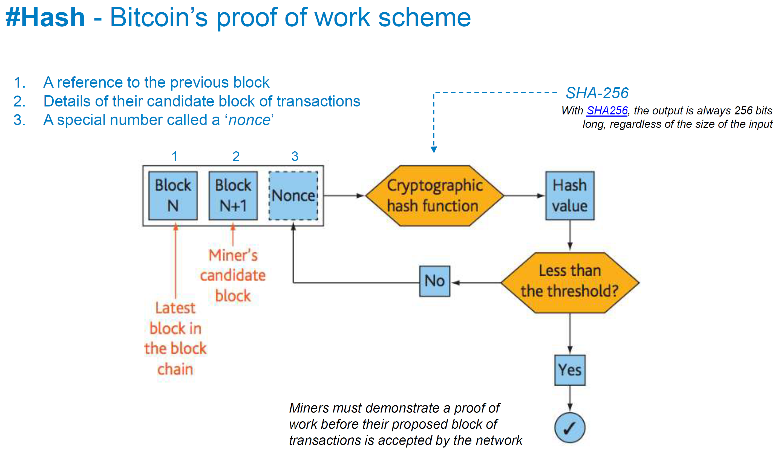

Slide 27
Mining Demo
Notes:
https://anders.com/blockchain/hash.html

Slide 28
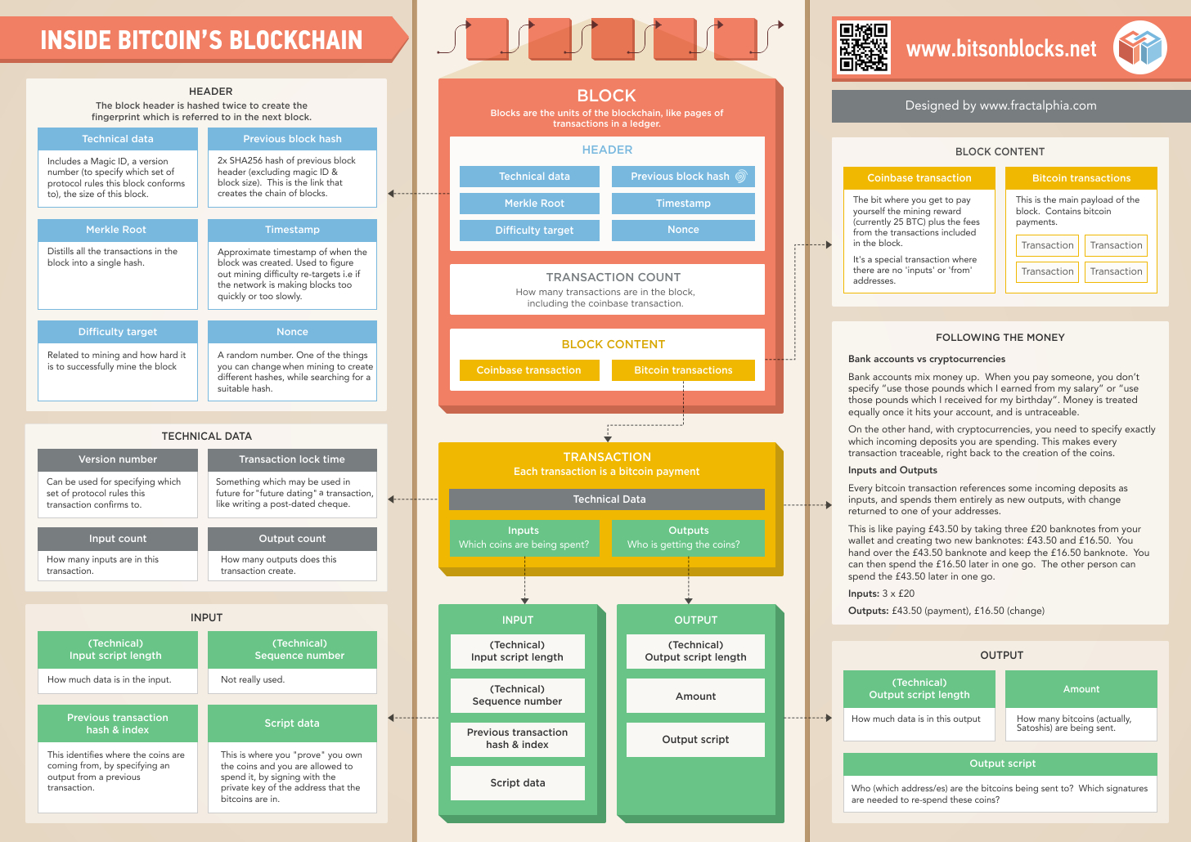

Slide 29
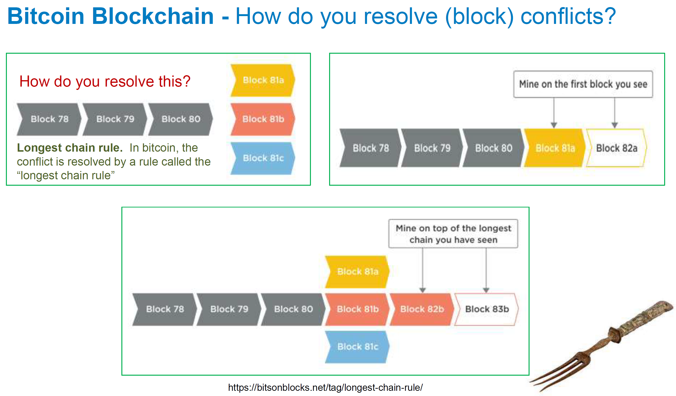

Slide 30
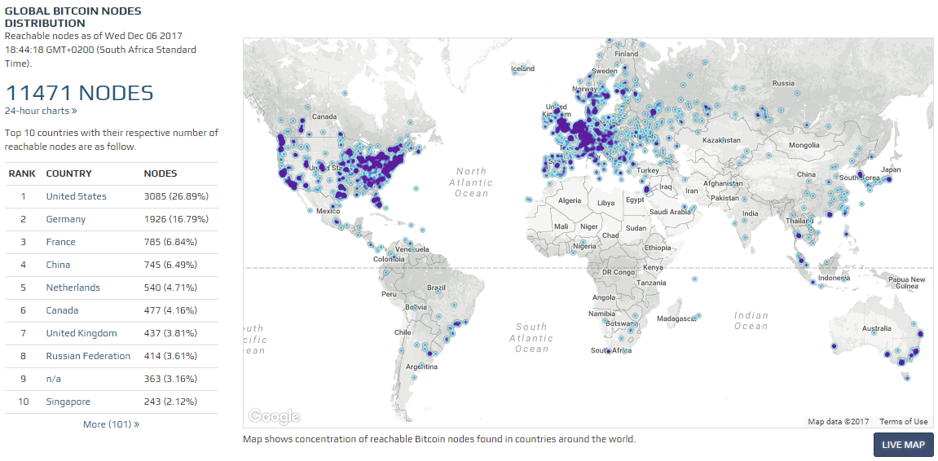

Slide 31
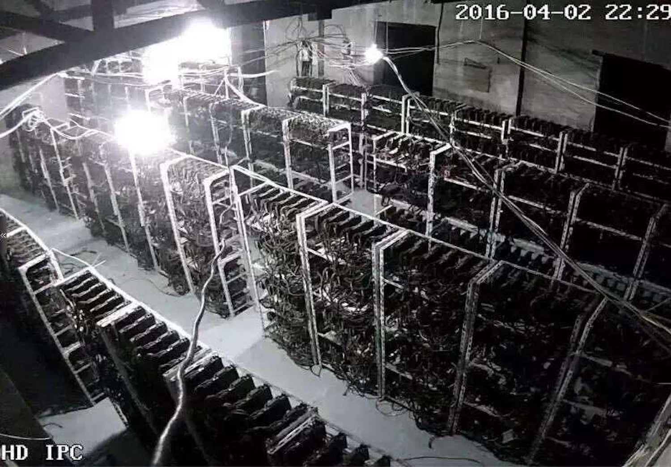

Slide 32
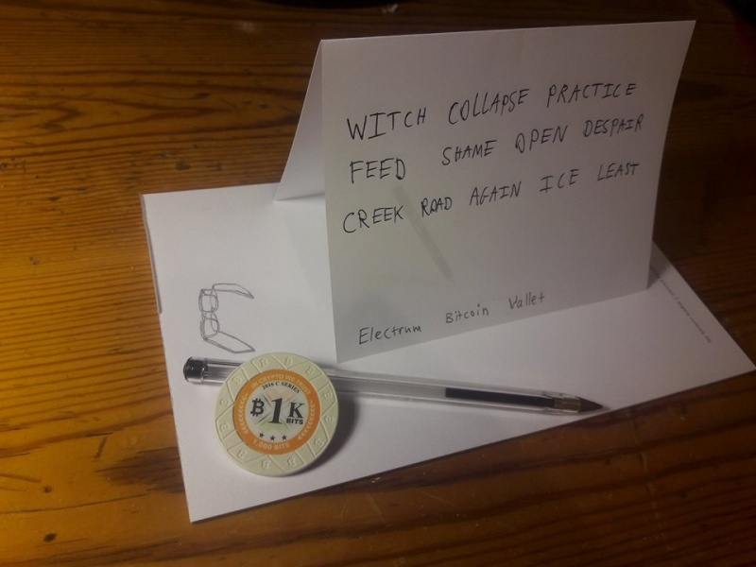
Notes:
Mnemonic Phrase
2024¹² ~= 5.444 x 10³⁹

Slide 33
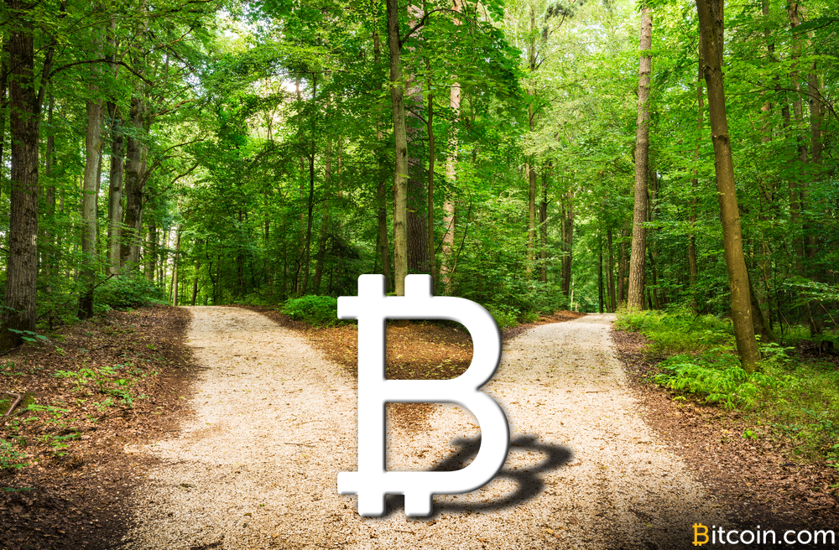

Slide 34
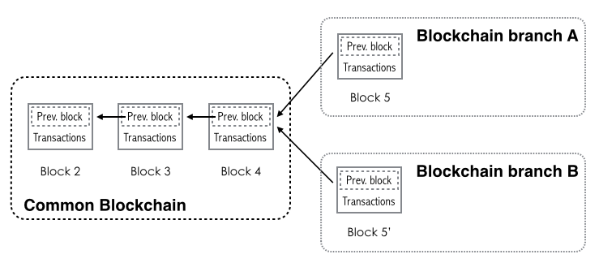

Slide 35
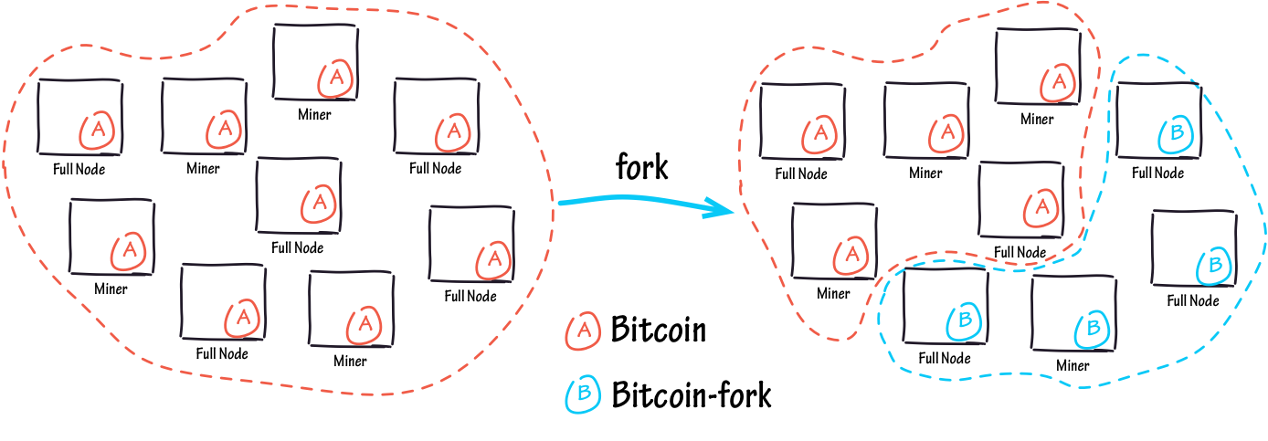

Slide 36
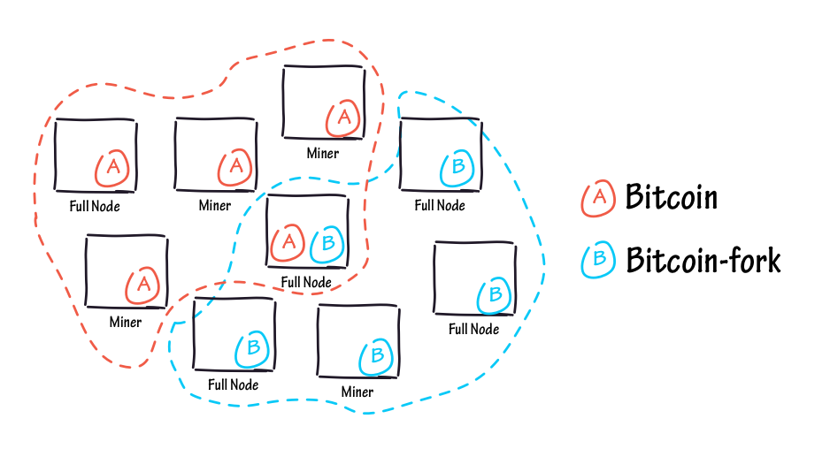

Slide 37
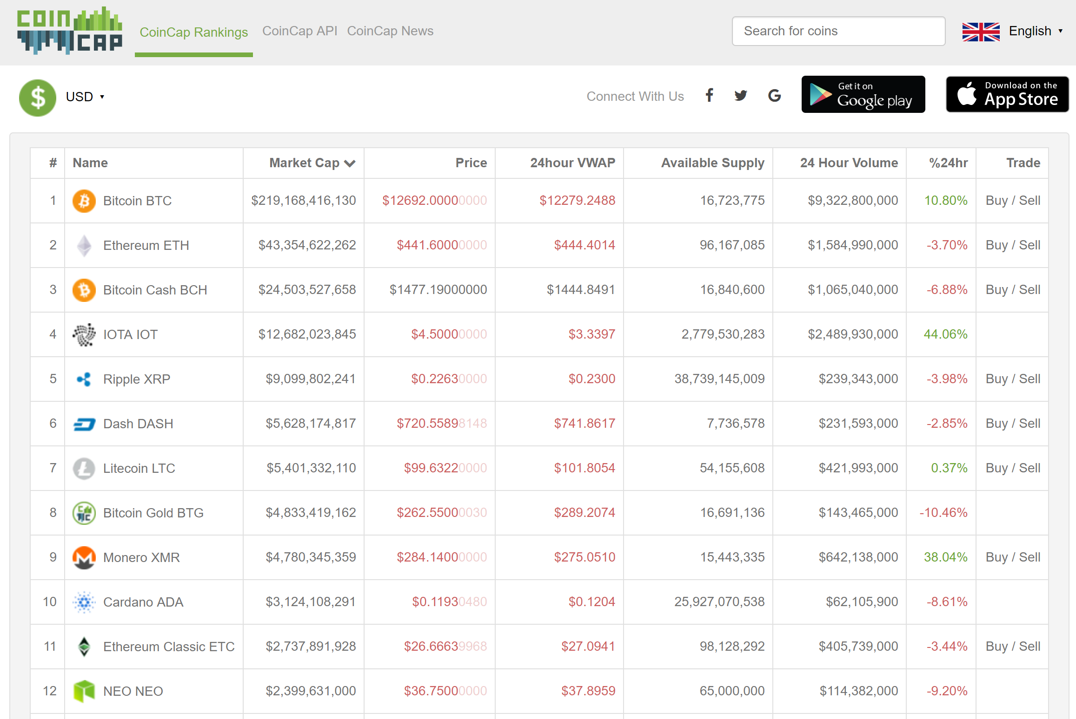

Slide 38
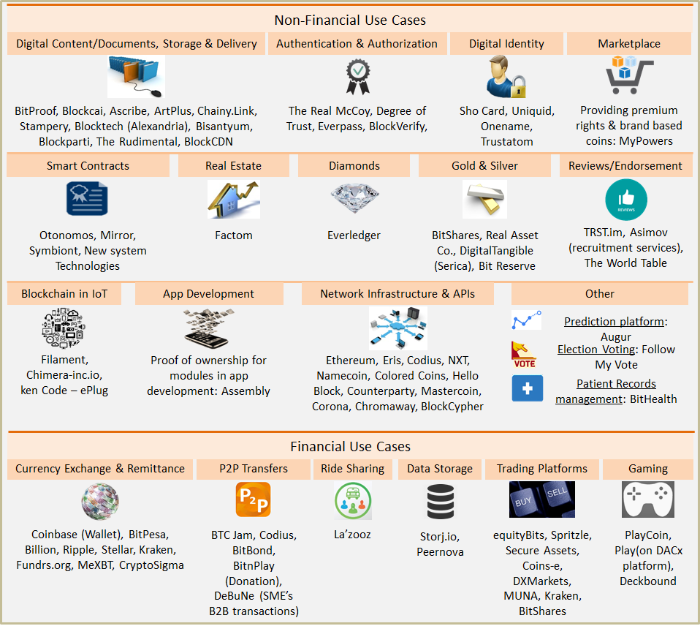

Slide 39


Slide 40
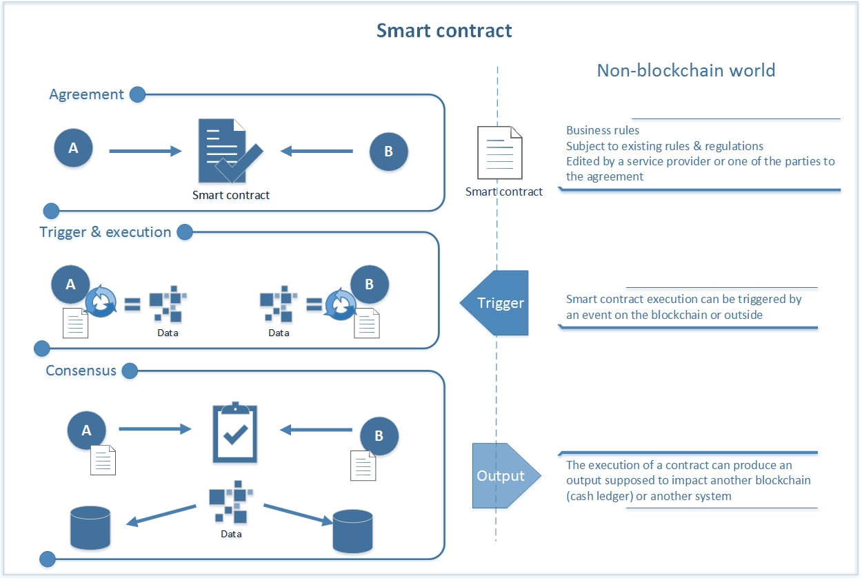

Slide 41

Notes:
Distributed Autonomous Organization

Slide 42
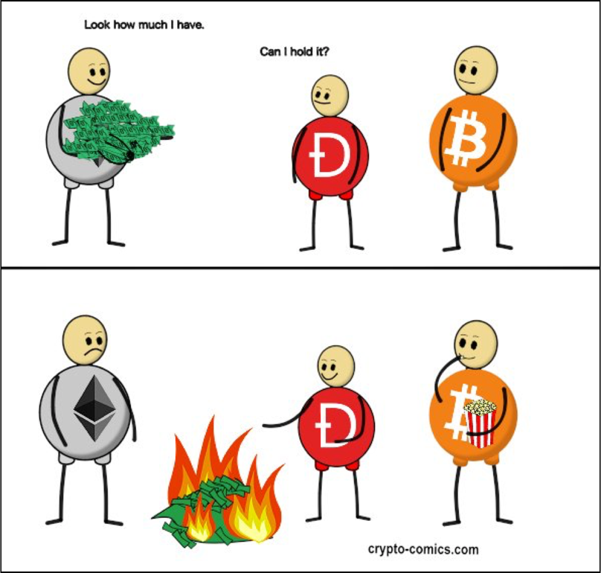

Slide 43
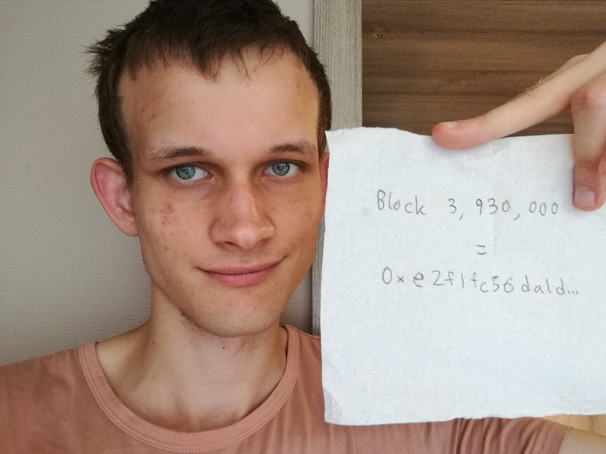

Slide 44
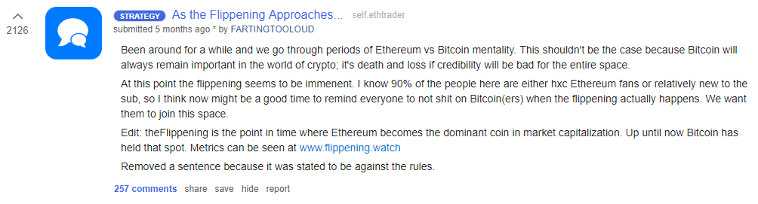

Slide 45
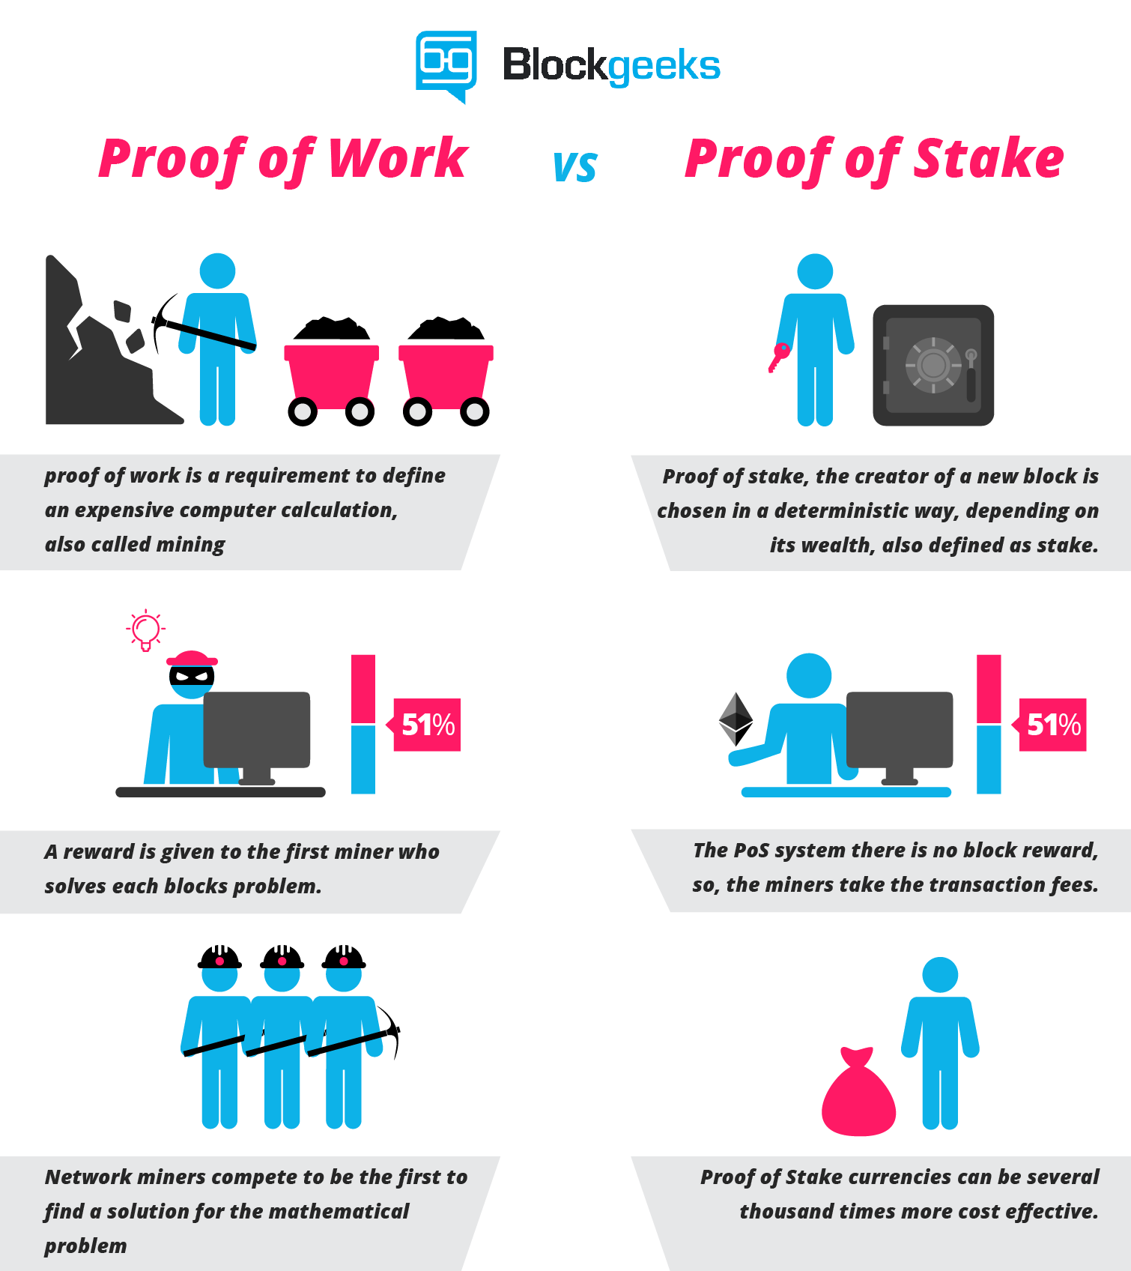

Slide 46


Slide 47
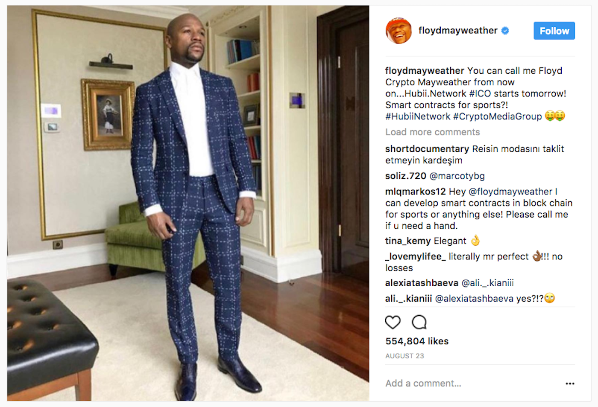
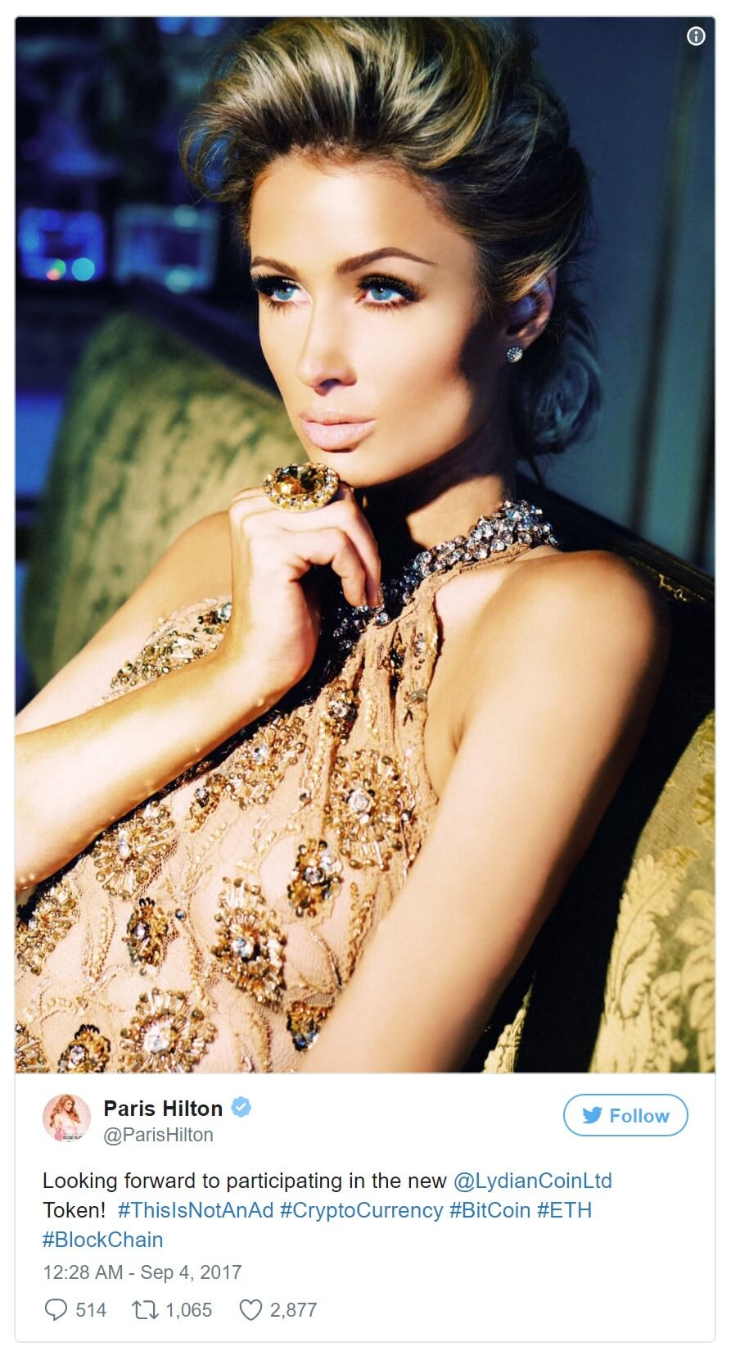

Slide 48


Slide 49


Slide 50

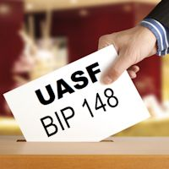


Slide 51
